Slide 1
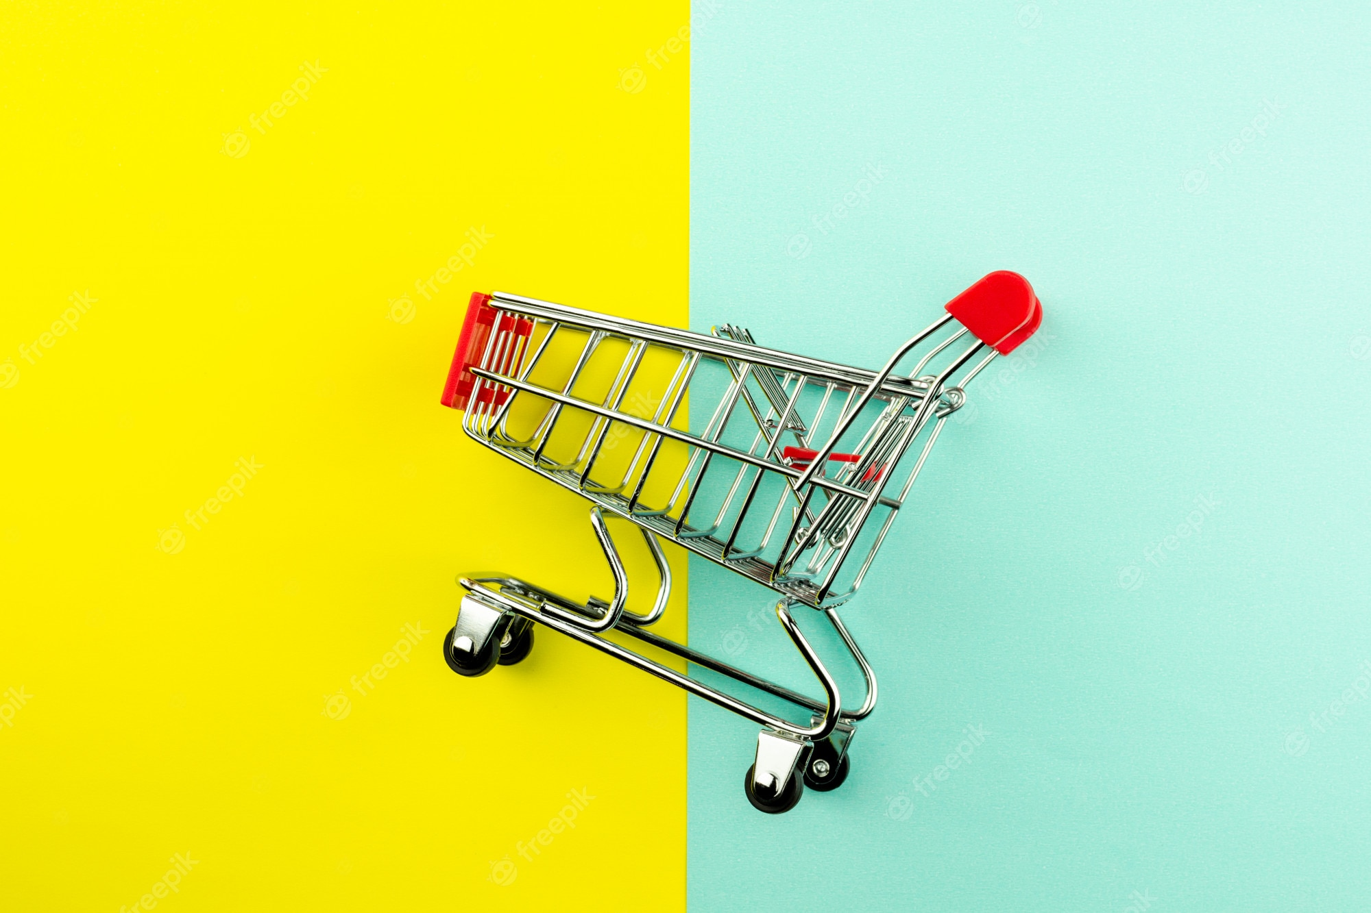


Shopping Cart Using OOP
Name : Sevak Aarsh Mukeshkumar
Enrollment : 21002171210150
Roll no :130
Branch :CSE Batch :4

Slide 2
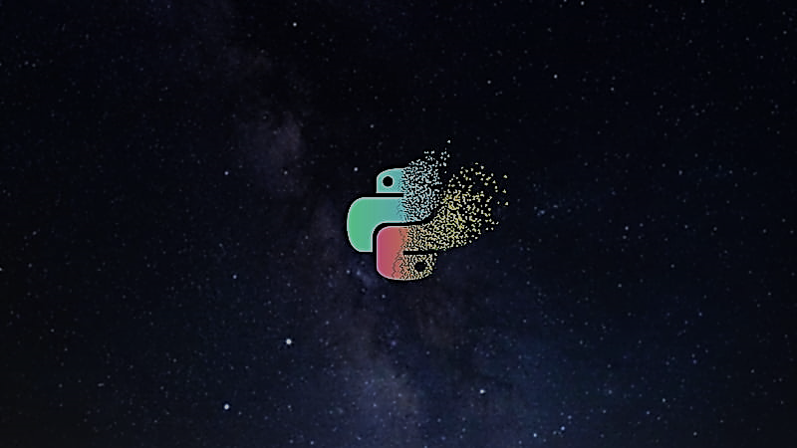
Shopping Cart :
A shopping cart is a software application that is used to facilitate online shopping. It is an essential part of any e-commerce website, allowing customers to add products to their cart and proceed to checkout to complete their purchase.
A shopping cart typically consists of two parts: the front-end interface, which is what the customer sees on the website, and the back-end functionality, which is responsible for processing orders and managing inventory.
On the front-end, the shopping cart interface displays the items that the customer has added to their cart, along with the quantity, price, and any other relevant details. The customer can then modify their cart by adding or removing items, or changing the quantity of items.
On the back-end, the shopping cart software is responsible for processing payments, updating inventory, and sending confirmation emails to the customer. It may also integrate with other software, such as accounting software or shipping providers, to automate these processes and streamline the overall shopping experience.
Overall, a shopping cart is a vital component of any e-commerce website, helping businesses to manage their online sales, improve customer experience, and increase revenue.

Slide 3
Project Outline:-
Two Classes are used :
1.Shopping_cart
2.Item
The Shopping cart contains mainly 4 methods i.e. add ,remove,price and list to cart .
The Item class contains Price and name .
On moving further we have different functions.
makeStoreItems
CreateStore
listStore
printInstructions
removeItem
handleInput

Slide 4
Method To Use The Module :
A shopping cart is software that makes it possible for customers to select products and buy them online.
Here is a such model which helps user to pick up products from the available products .
Step 1 : User have to just have to start the kernel and then a preface will get open in which the available items will be displayed and select any of the needed products
Step-2: The panel will again be displayed for further shopping . If user wants to continue then continue .
Step-3 : To view the cart user will have to type ‘C’ and his cart will be displayed .
Step-4 : To get the Total price type ’P’ and cart price will be displayed
Step-5 : Type ‘X’ to exit the cart .

Slide 5
Some of the merits of a shopping cart created in Python :
Scalability: Python is highly scalable, which means that the shopping cart can easily handle a large number of products and transactions without slowing down.
Flexibility: Python allows for easy customization and integration with other technologies, making it flexible for creating a shopping cart that meets specific business needs.
Security: Python has built-in security features that can help to protect user data and transactions, ensuring that the shopping cart is safe for customers to use.
Easy to learn: Python is a popular programming language with a simple syntax, making it easy for developers to learn and use to create a shopping cart.
Cross-platform compatibility: Python can run on various platforms, including Windows, Linux, and macOS, making it a suitable choice for creating a shopping cart that can be accessed from different devices.
Overall, Python is a powerful language that can help to create a robust and reliable shopping cart that meets the needs of both customers and businesses.

Slide 6
Some of the merits of a shopping cart created in Python :
Limited scalability: Depending on how the shopping cart is implemented, it may have limited scalability if it cannot handle a large number of concurrent users or a large volume of transactions.
Security vulnerabilities: If the shopping cart does not have proper security measures in place, it could be vulnerable to attacks such as SQL injection or cross-site scripting.
Lack of customization: Depending on the shopping cart implementation, there may be limited options for customization, which could make it difficult to add new features or modify existing ones.
Maintenance and support: If the shopping cart is created by a small team or individual, there may be limited resources available for maintenance and support, which could result in issues going unresolved or updates being infrequent.
Integration challenges: If the shopping cart needs to integrate with other systems or platforms, there could be challenges in ensuring compatibility and smooth data transfer.

Slide 7
THANKYOU
-AARSH SEVAK

